Slide 1
Fat boy kitchen
Created by GADSE20.1

Slide 2
Members of the group
M.G.AROSHA RAVISHAN - GADSE201F -020
T.P.W.B.SAMOD - GADSE201F- 011
H.B.D.FERNANDO - GADSE201F- 036
A.M.G.S.DE .SILVA - GADSE201F- 015
SASINDU ISHANKA – GADCSD201F- 010

Slide 3


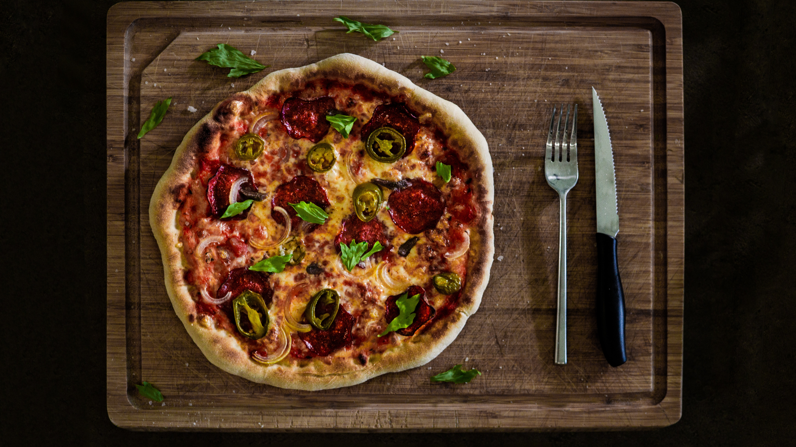
CONTENT
* Introduction
* Reasons for designed this website
* Facilities of the designed website

Slide 4

INTRODUCTION
* Our group created this web application to manage a restaurant. We planned food ordering system through online. In this system include admin panel to change the food item details.

Slide 5
REASON FOR DESIGN WEB APPLICATION
To improve & keeping business process during this COVID – 19 period.
To closer than before to customers.
To comfortable for customers.
To further increase customer confidence in the services of the business.
Increase further management with modern technology.

Slide 6
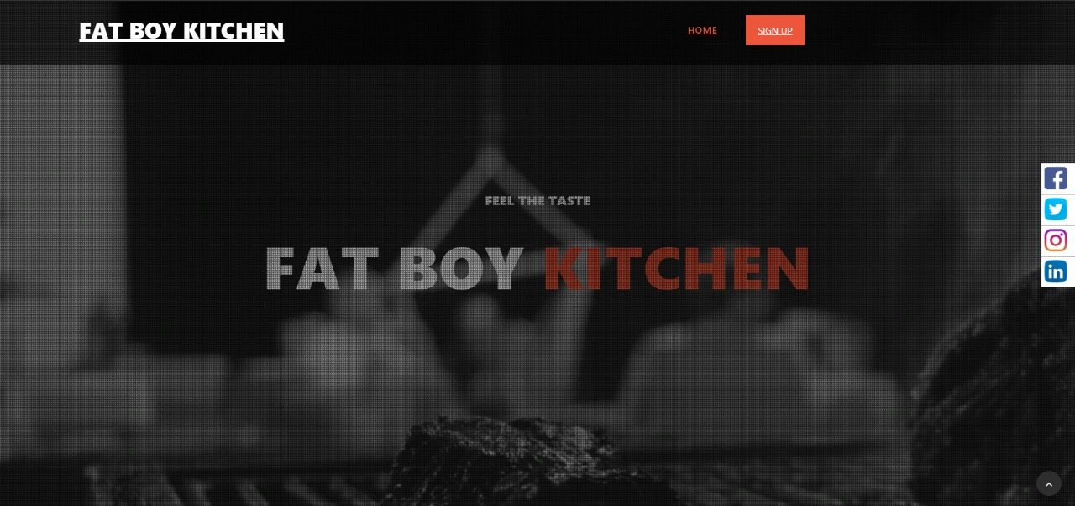
HOME PAGE

Slide 7
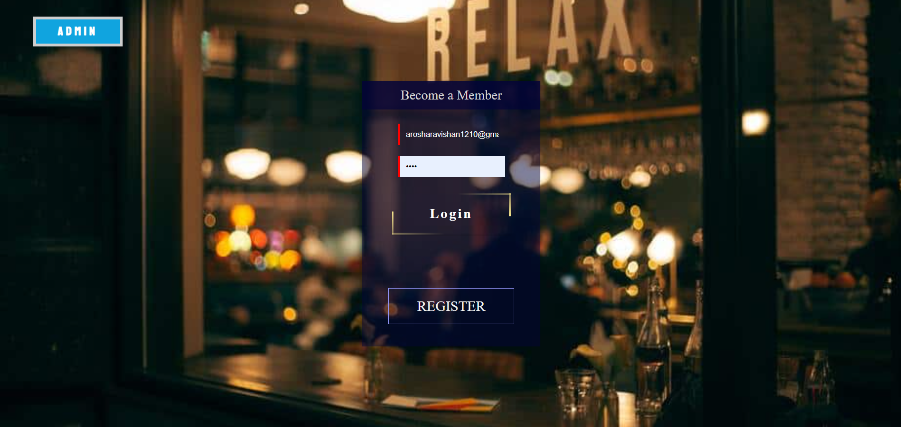
Login page

Slide 8
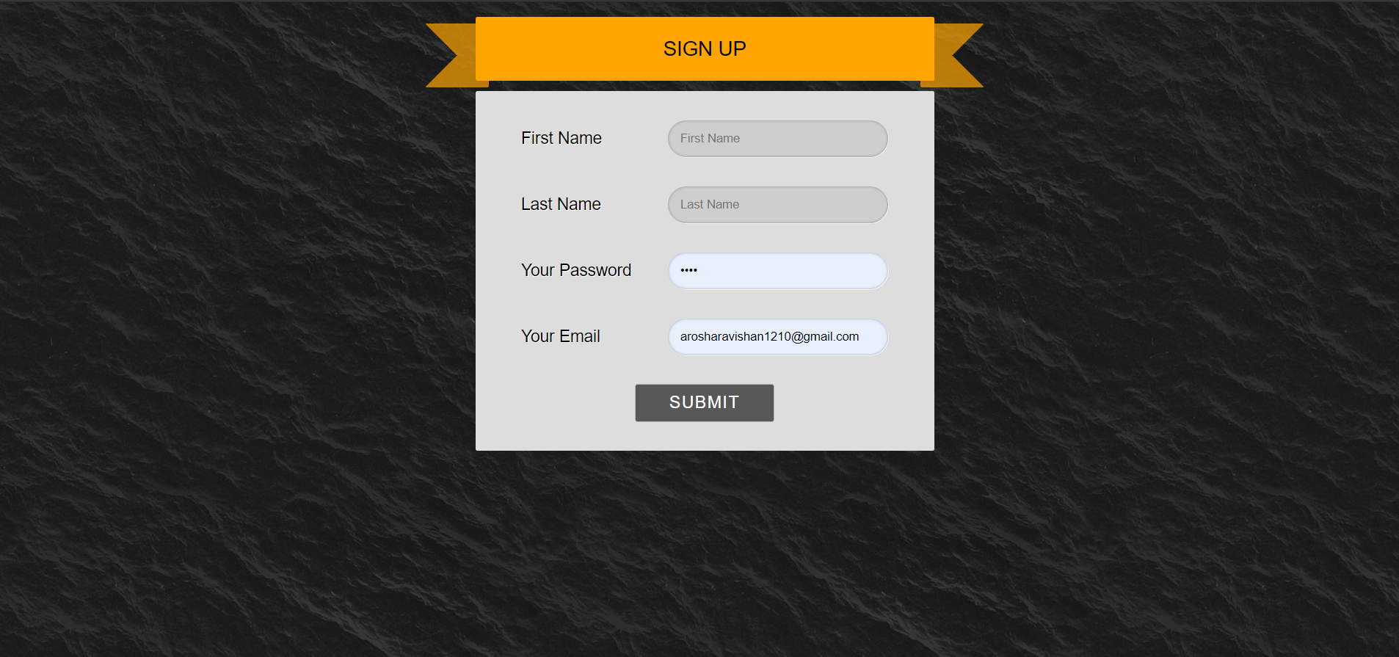
Sign up page

Slide 9
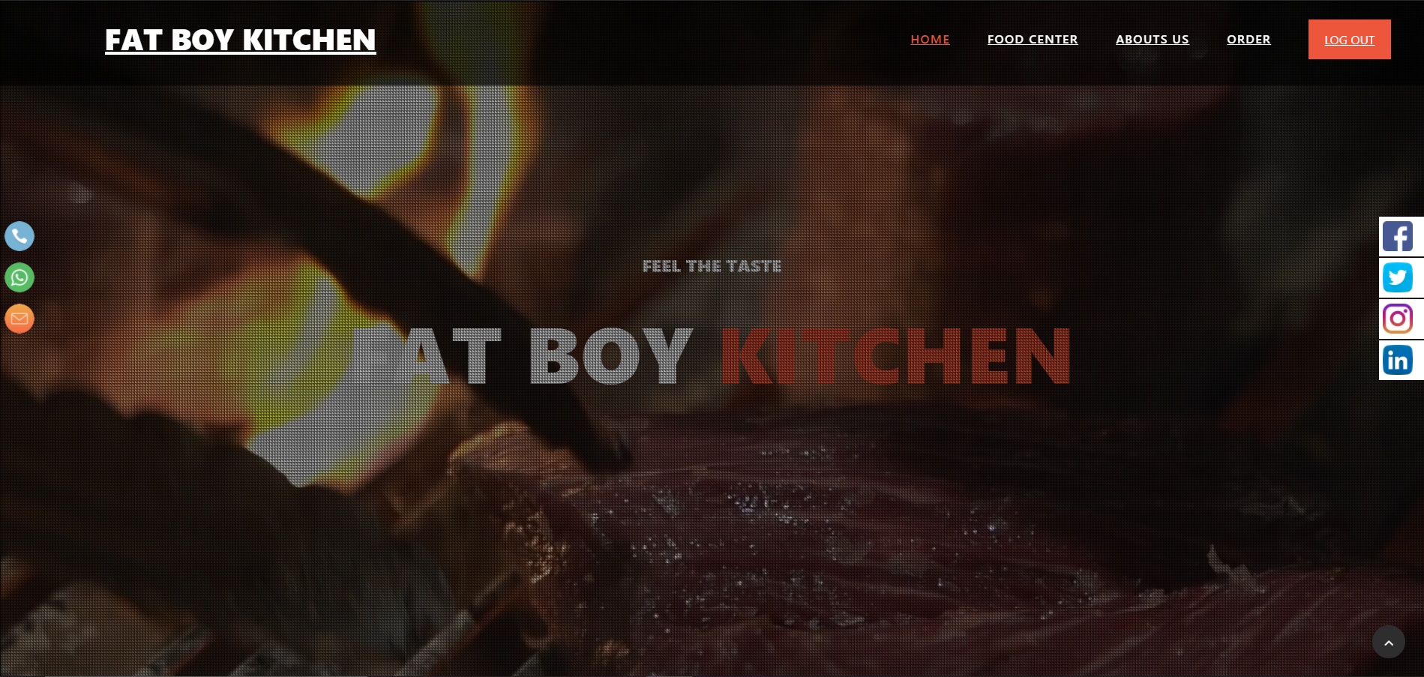
HOME PAGE

Slide 10
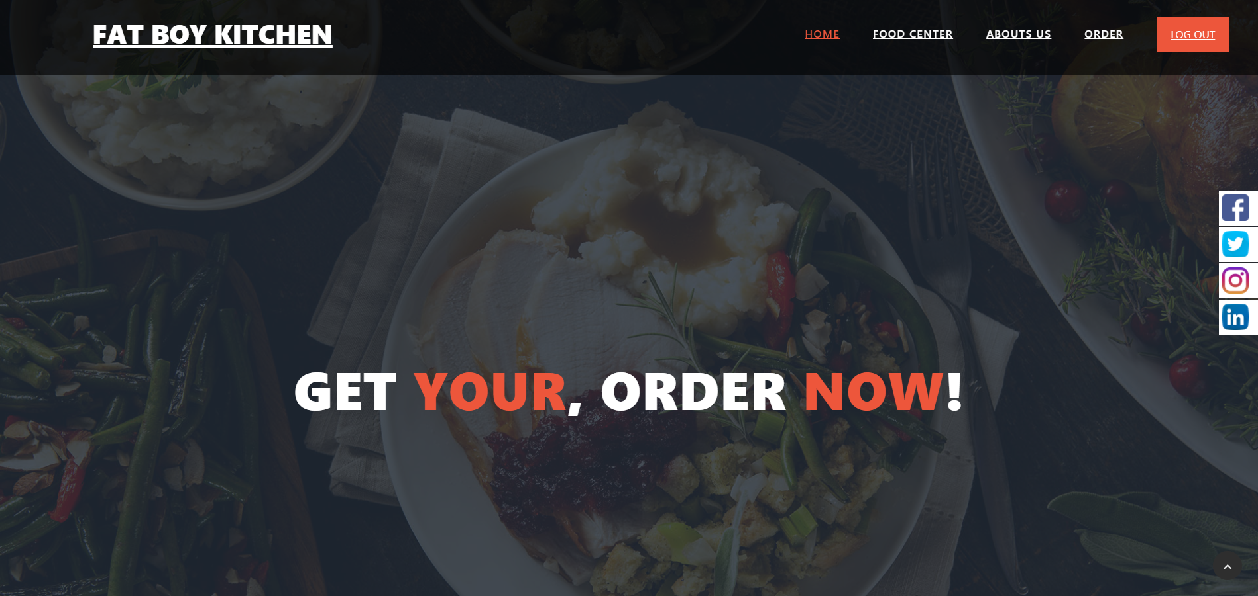
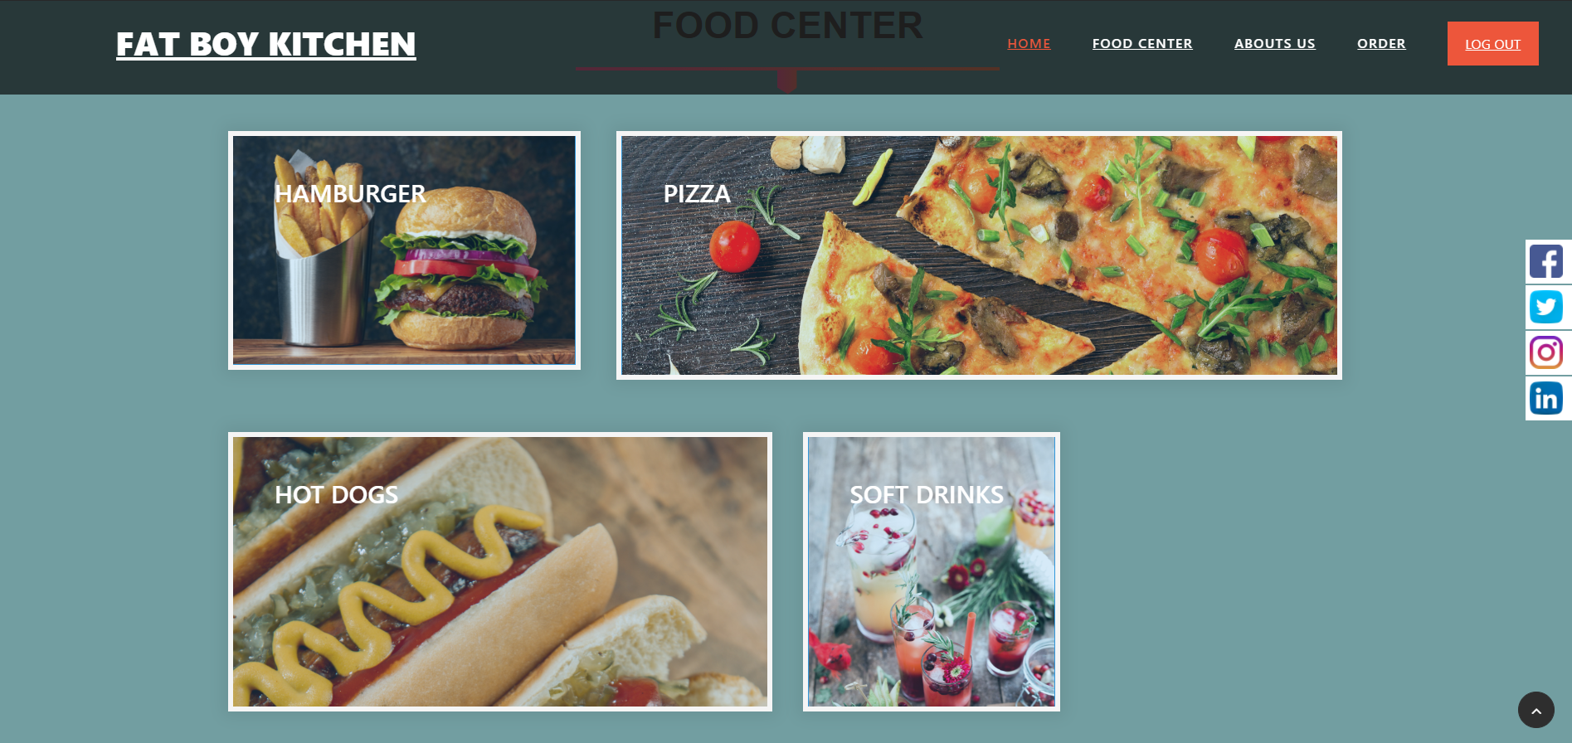
FOOD CENTER & ORDER MENU
Customer can Select Food Item
From Our FOOD CENTER

Slide 11
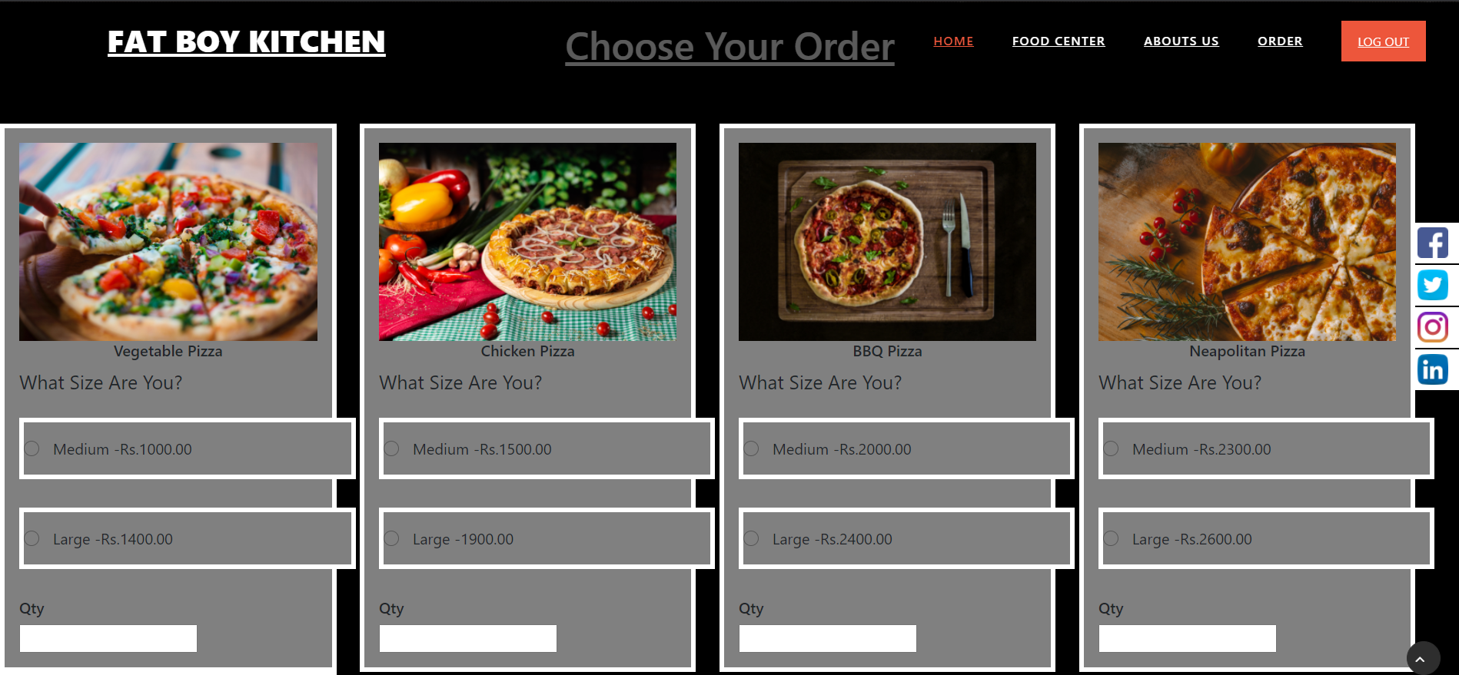
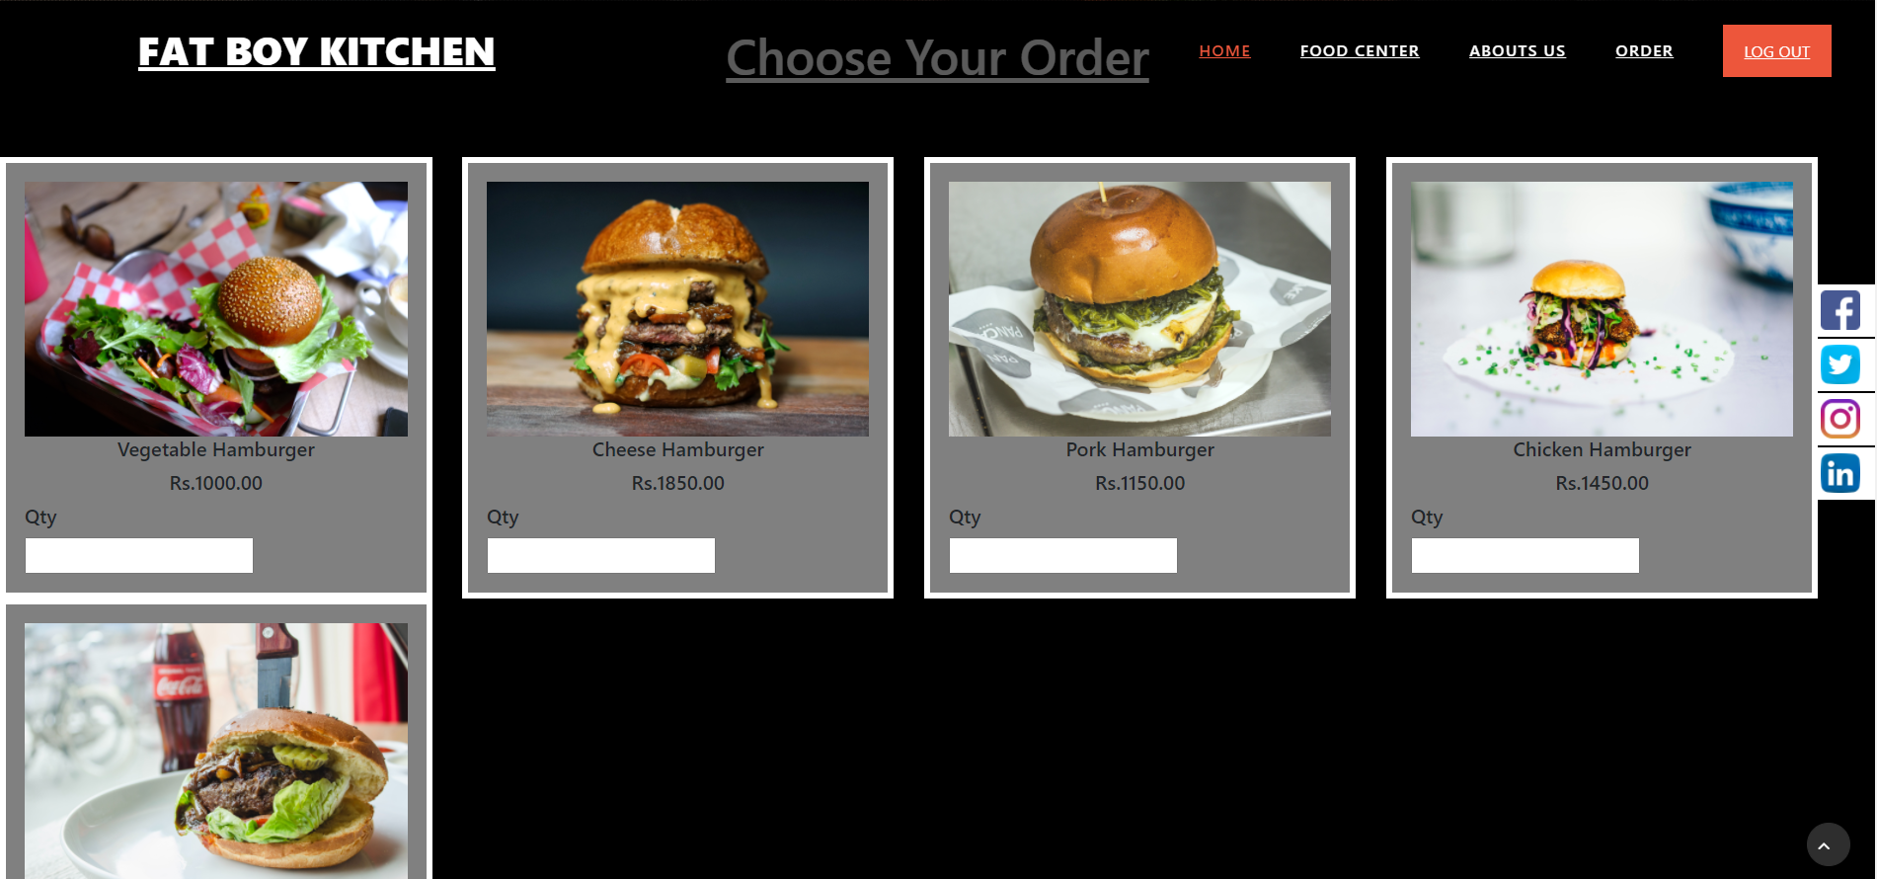
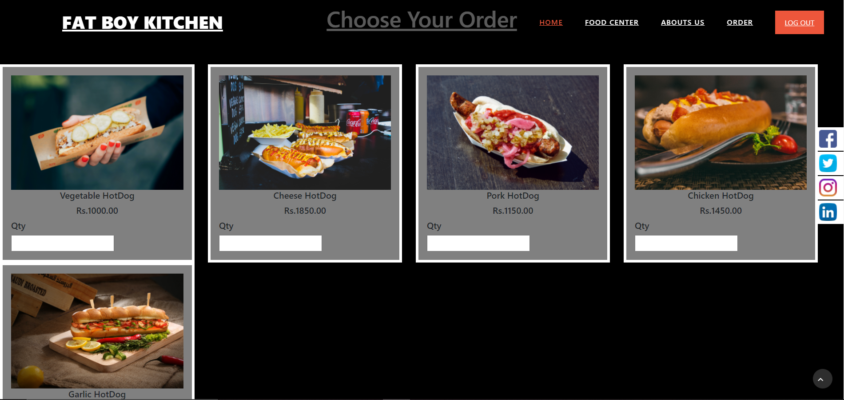
Food items
pizza
hamburger
Hot dogs

Slide 12
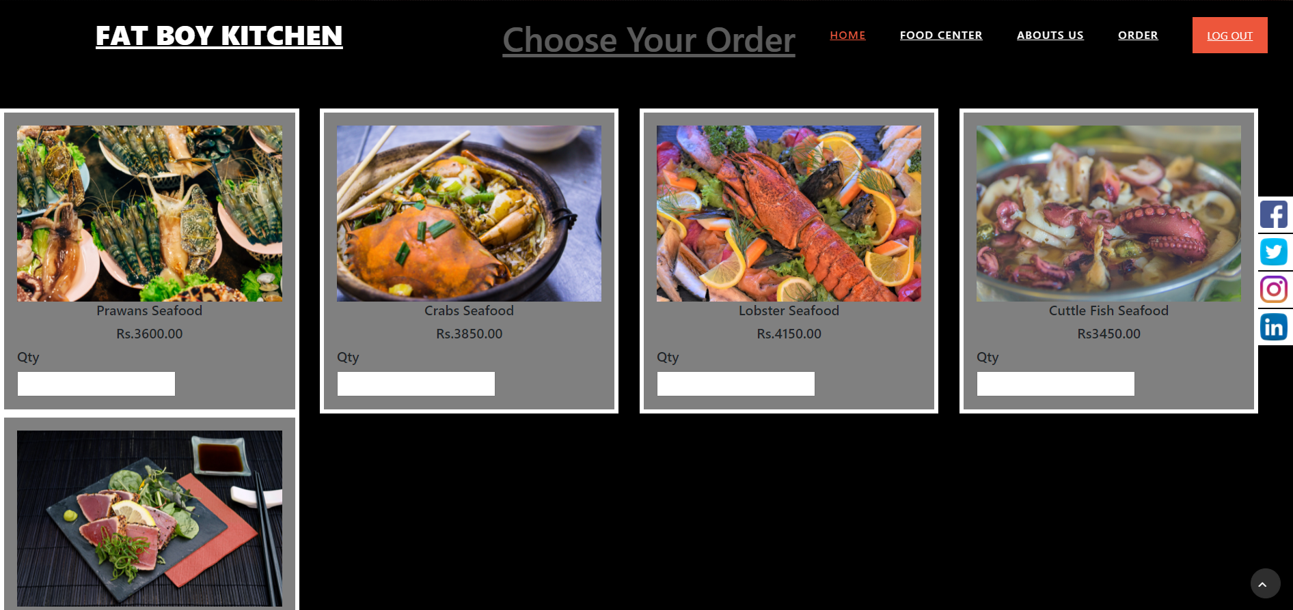
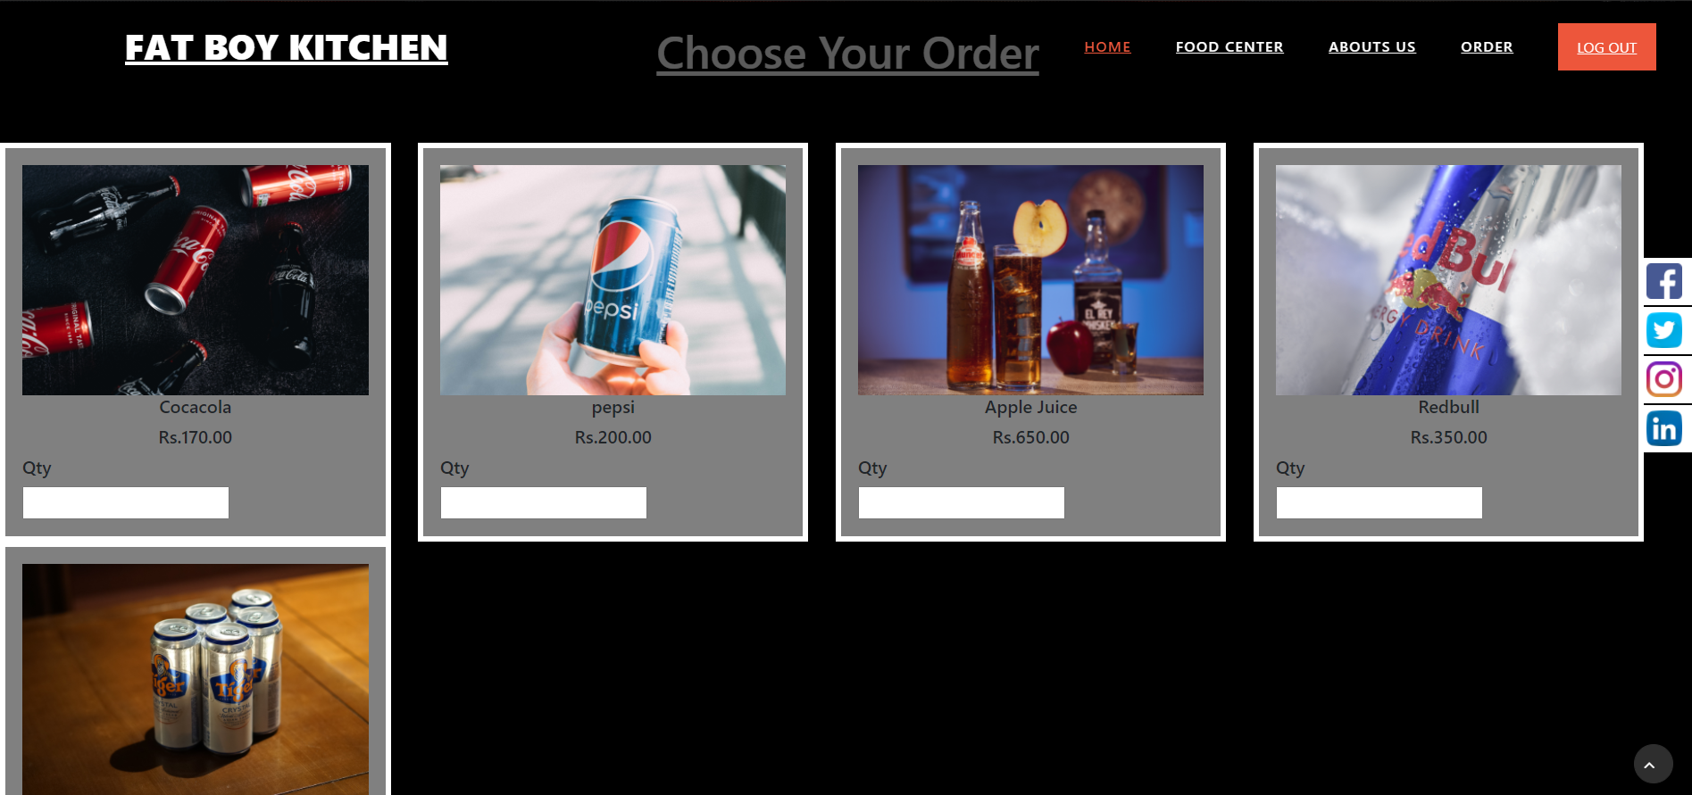
Food items
Sea food
Soft drinks

Slide 13
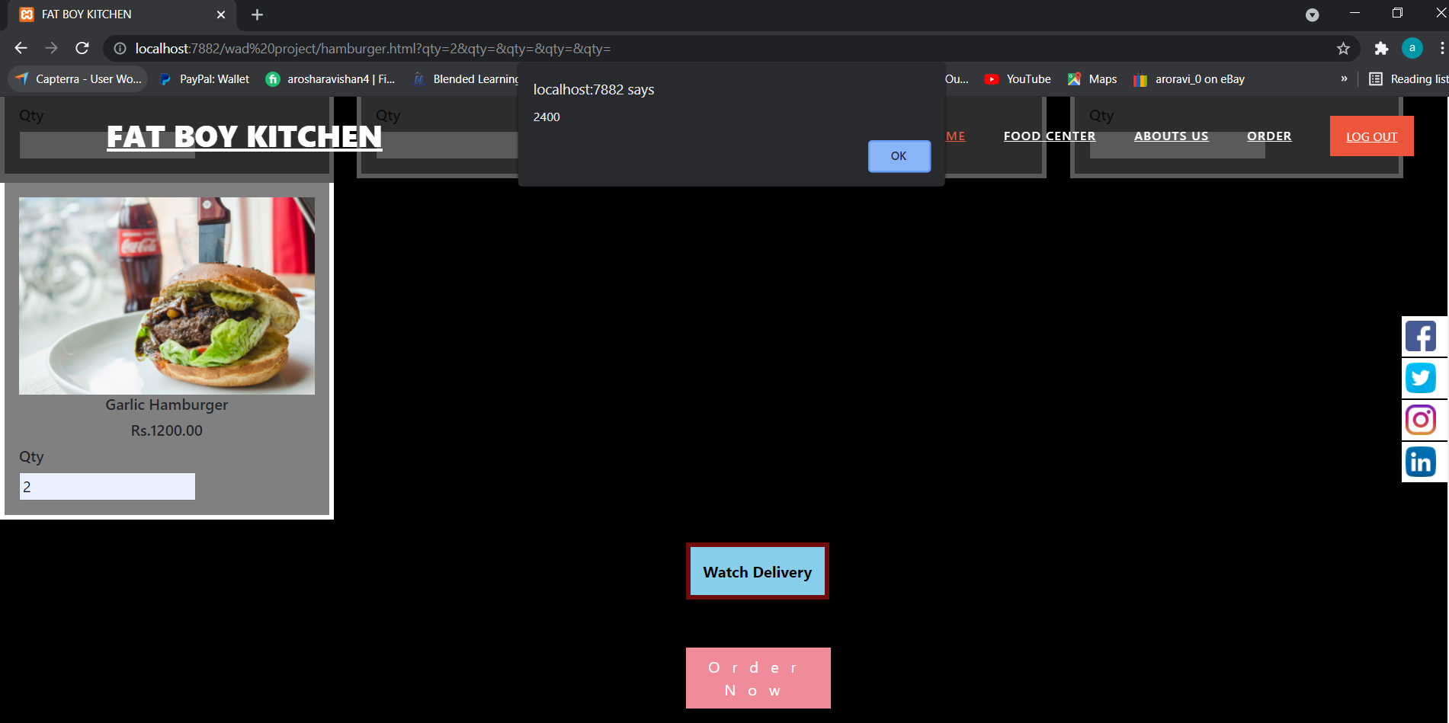
Order calculation
When you enter quantity and click the
order now button then price is display
price of order

Slide 14
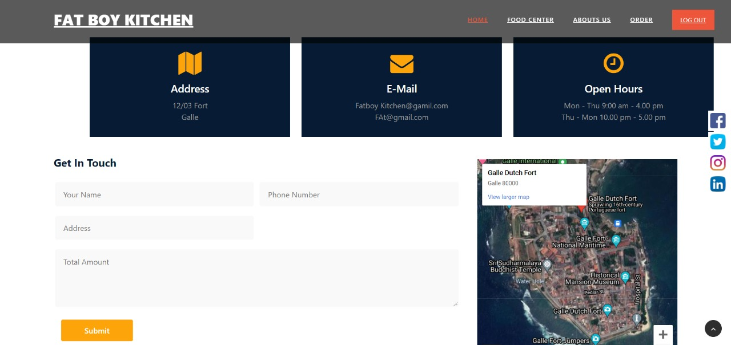
Order now

Slide 15
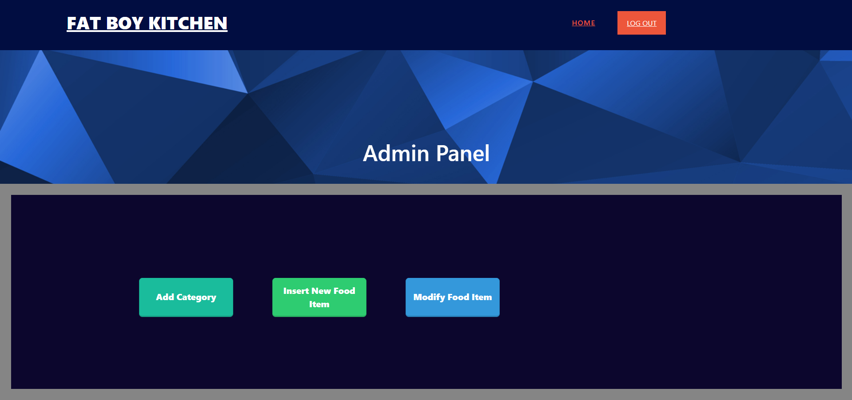
Admin panel
Add category
Insert Food items
Modify Food items

Slide 16
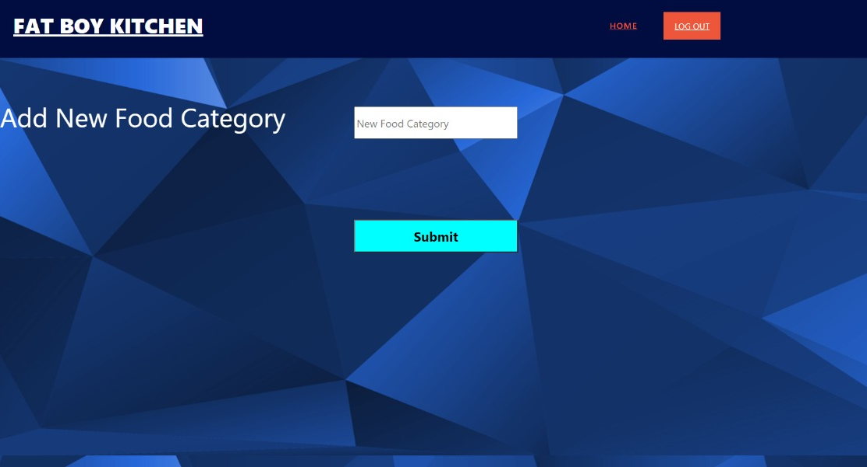
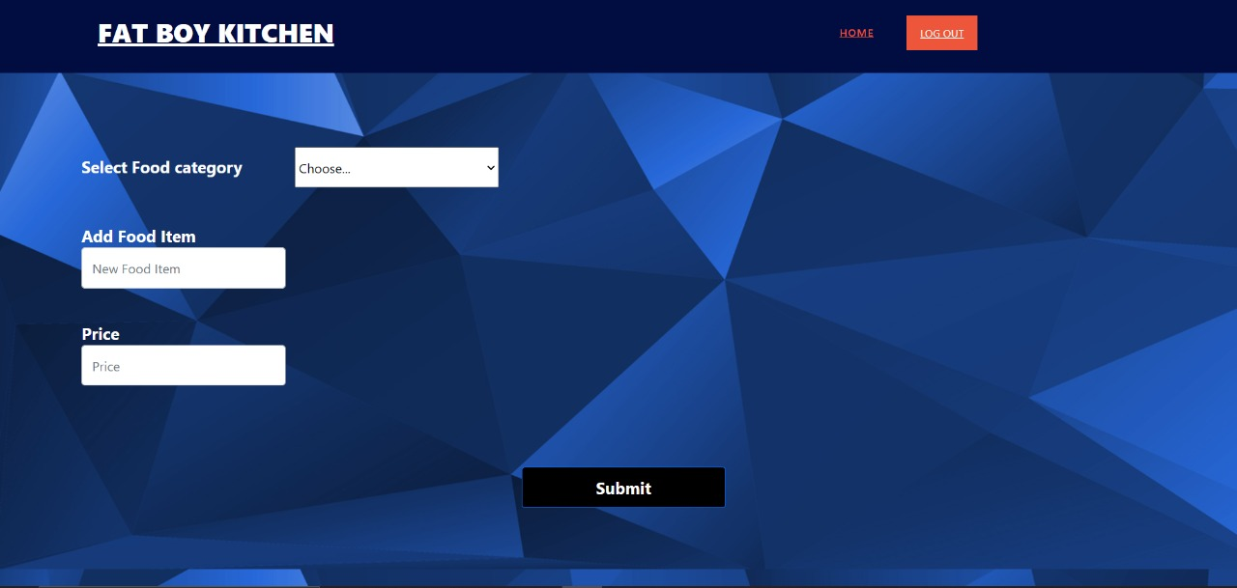
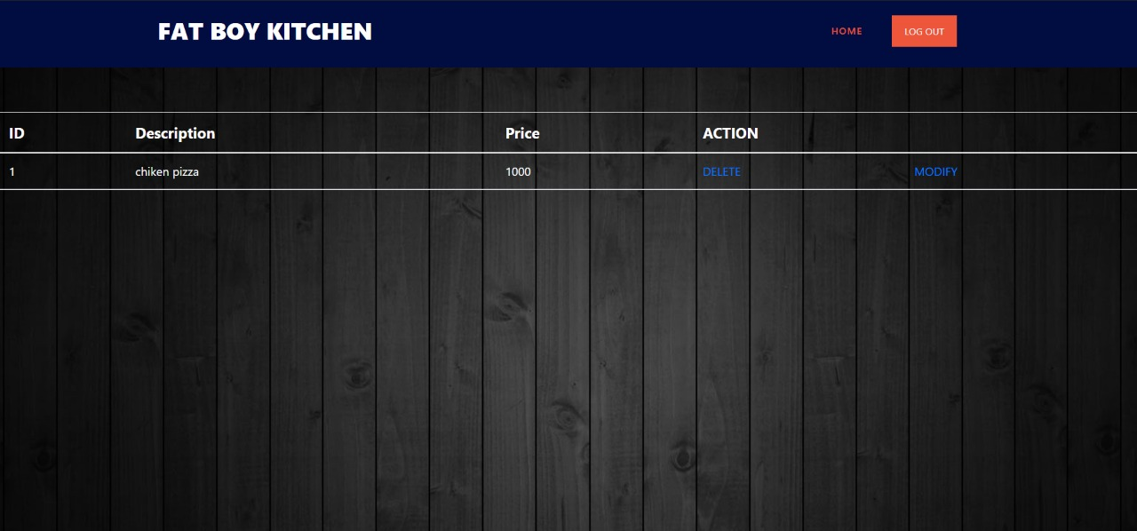
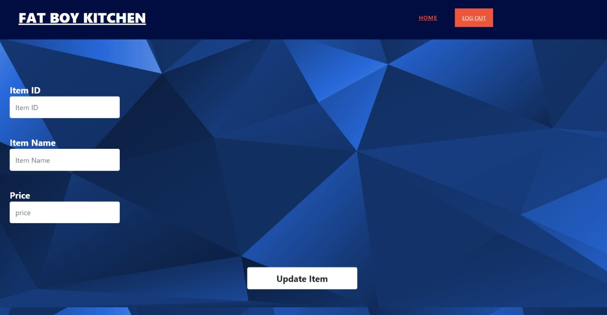
Admin panel
Add category
Insert Food items
update Food items
Modify Food items

Slide 17
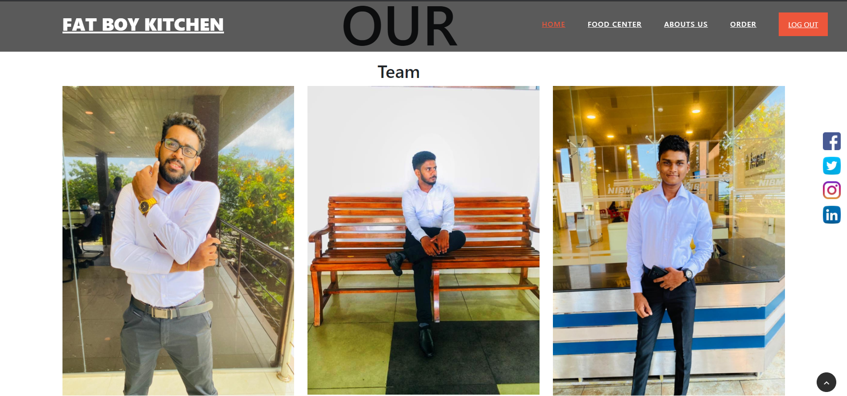
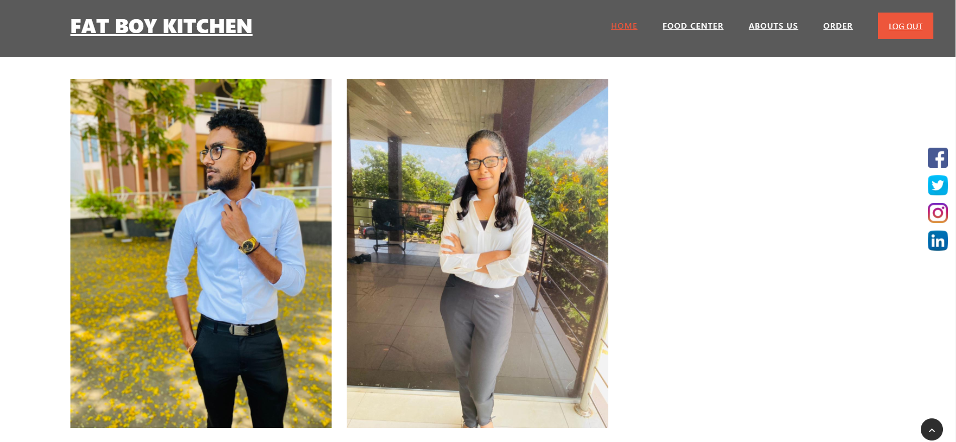
Our team
M.G.AROSHA RAVISHAN
T.P.W.B.SAMOD
H.B.D.FERNANDO
A.M.G.S.DE .SILVA
SASINDU ISHANKA

Slide 18
FACILITIES OF DESIGNED WEB APPLICATION
* Not need manual calculation.
* Not need keeping information into manual document and files.
* Easy to use customers.
* Easy to handle orders.
* Transactions are made in such a way that customer information in secure.

Slide 19

ANY Question ?

Slide 20

Thank you !

